Slide 1
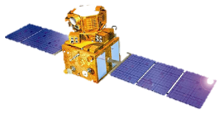
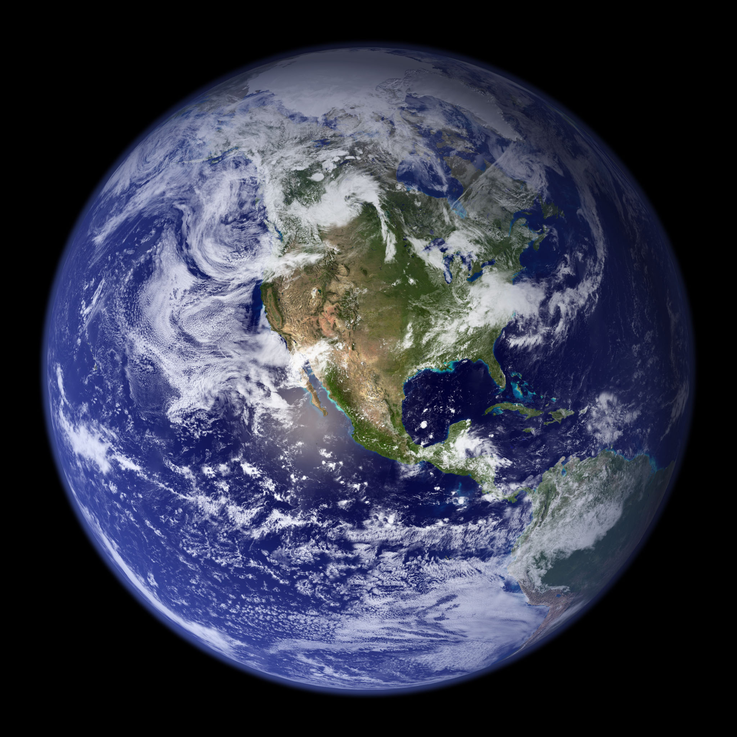
Non-Linear Control Applied to Continuous Low Thrust Orbital Transfer
Patrick Serafin

Slide 2



About Me
Bachelors, Aerospace Engineering ‘19
Engineering Physics Propulsion Lab
Research & Development Co-Op
Spring 2017 - Human Factors
Fall 2017 - Structural Design
Summer 2018 - Flight Test Engineering
GNC Analyst
Dream Chaser
Artemis – Dynetics Human Landing System

Slide 3
Problem Statement
Control orbit transfer from Low Earth Orbit to Geostationary Orbit for spacecraft limited to low thrust capability (ion thruster / solar sail)

Slide 4
Assumptions
Initial and final orbits are:
Co-planer
Circular

Slide 5
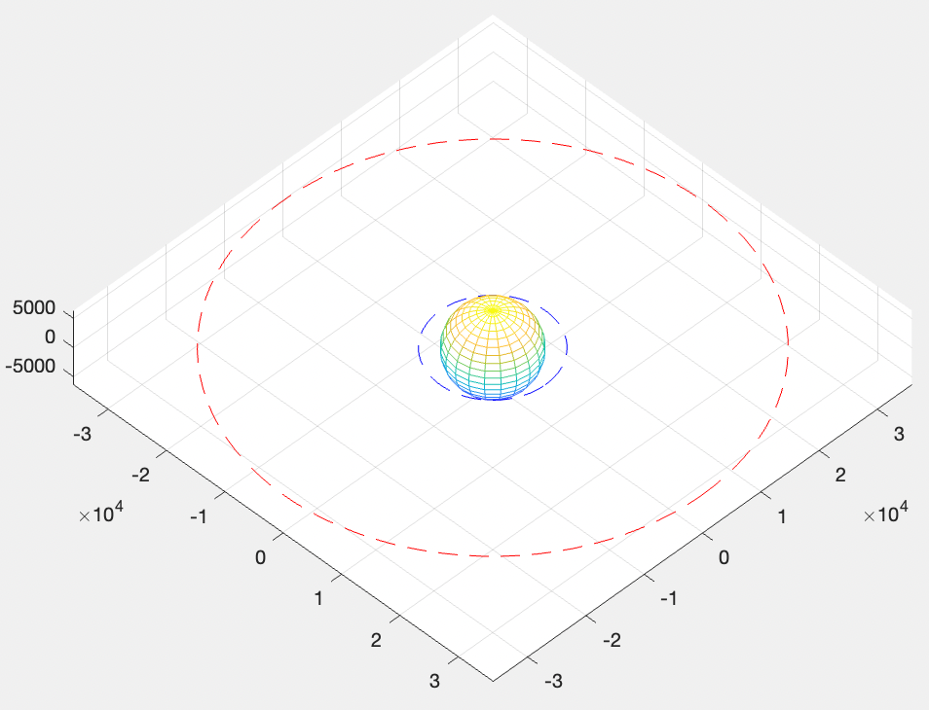
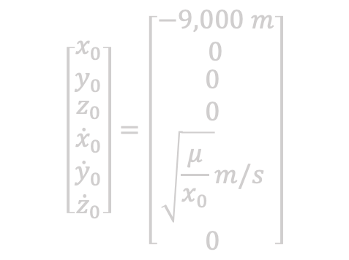
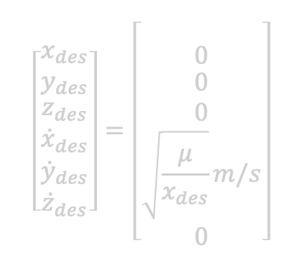
Boundary Conditions
Initial State
Final State
$$\left[\begin{matrix}x_{0} \\ y_{0} \\ \begin{aligned}z_{0} \\ {\dot{x}}_{0} \\ {\dot{y}}_{0} \\ {\dot{z}}_{0}\end{aligned}\end{matrix}\right]=\left[\begin{matrix}−9,000 m \\ 0 \\ \begin{aligned}0 \\ 0 \\ \sqrt{\frac{μ}{x_{0}} }m/s \\ 0\end{aligned} \end{matrix}\right]$$
$$\left[\begin{matrix}x_{des} \\ y_{des} \\ \begin{aligned}z_{des} \\ {\dot{x}}_{des} \\ {\dot{y}}_{des} \\ {\dot{z}}_{des}\end{aligned}\end{matrix}\right]=\left[\begin{matrix}\text{35786 }m \\ 0 \\ \begin{aligned}0 \\ 0 \\ \sqrt{\frac{μ}{x_{des}}}m/s \\ 0\end{aligned}\end{matrix}\right]$$

Slide 6





Spacecraft Parameters
$$m_{0}=100kg$$
$$T=1 N$$
$$ISP=2000 s$$
$$\frac{dm}{dT}=2$$
I = $\left[\begin{matrix}\frac{1}{12}Mh^{2}+\frac{1}{4}MR^{2} & 0 & 0 \\ 0 & \frac{1}{12}Mh^{2}+\frac{1}{4}MR^{2} & 0 \\ 0 & 0 & \frac{1}{2}MR^{2}\end{matrix}\right]$

Slide 7
Baseline Solution – Using Hohmann Transfer
Transfer from Low Earth Orbit to Geostationary Orbit using continuous low thrust maneuver.

Slide 8
Frame Definitions
A

Slide 9
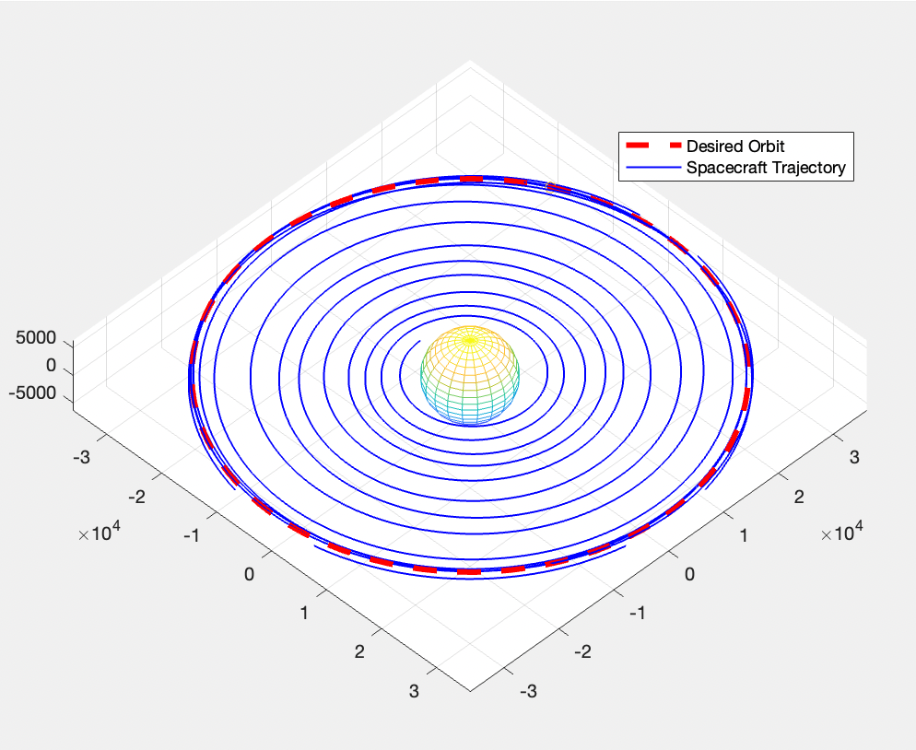
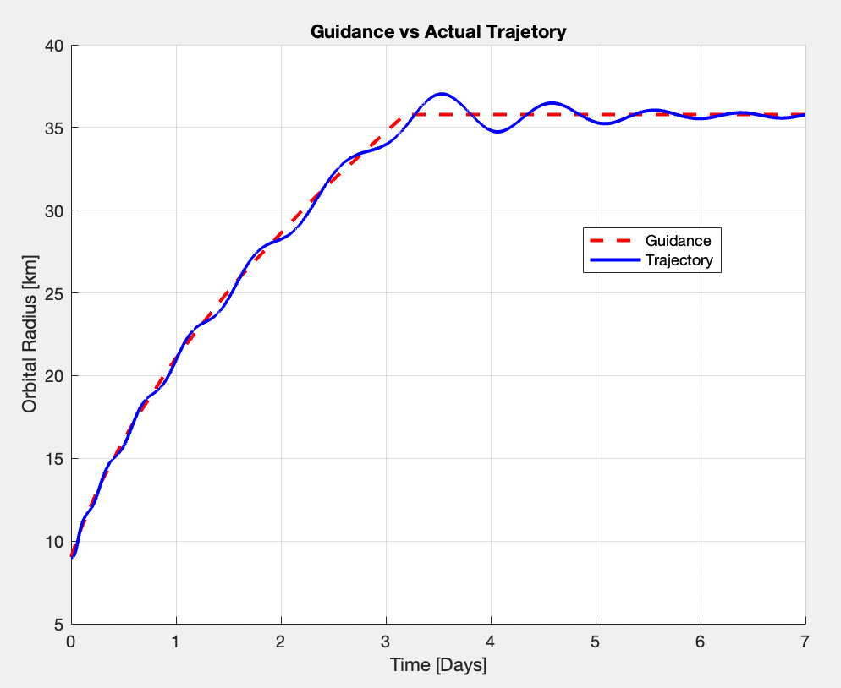
Results

Slide 10
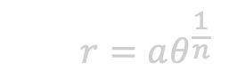
Q Guidance – Reference Trajectory Design
Fermat’s Spiral – Increasing
Fermat’s Spiral – Decreasing
Circularize
Max rate of acceleration
$$r=aθ^{\frac{1}{n}}$$

Slide 11
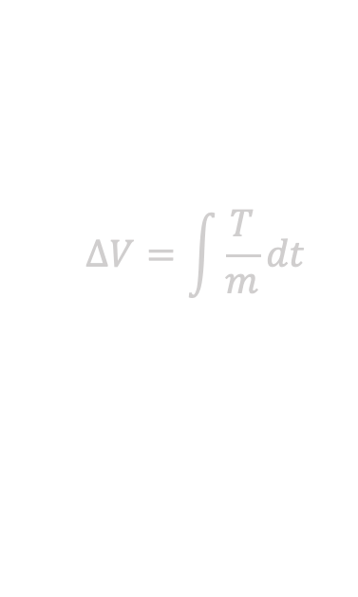


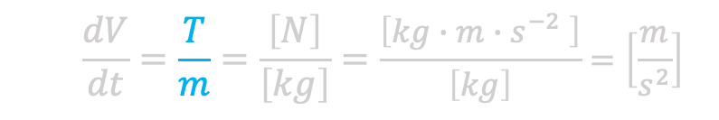
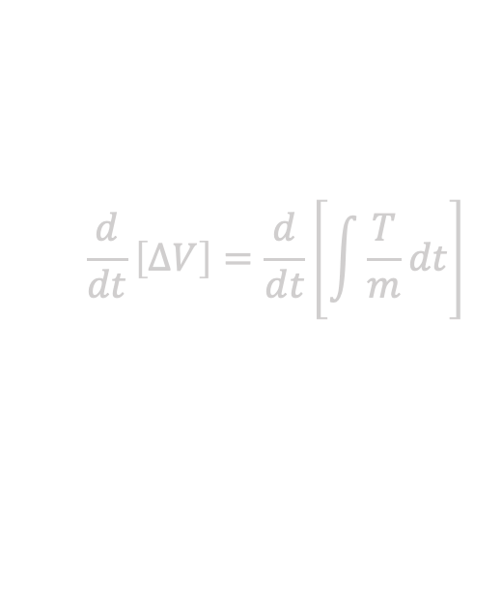
Reference Trajectory Design
$$\frac{d}{dt}\left[ΔV\right]=\frac{d}{dt}\left[\int{\frac{T}{m}dt}\right]$$
Maximum acceleration
From the well known $ΔV$ equation:
$$ΔV=\int{\frac{T}{m}dt}$$
$$\frac{dV}{dt}=\frac{T}{m}=\frac{\left[N\right]}{\left[kg\right]}=\frac{\left[kg∙m∙s^{−2} \right]}{\left[kg\right]}=\left[\frac{m}{s^{2}}\right]$$
$$\frac{T}{m}=\frac{10 N}{100 kg}=\frac{1}{10}\frac{m}{s^{2}}$$
Upper Bound on Net Acceleration

Slide 13

Spirals
$$r=aθ^{\frac{1}{n}}$$
In polar coordinates:

Slide 14

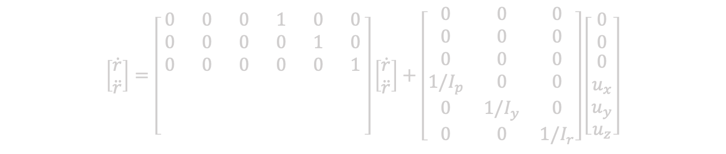

Equations of Motion
$$\dot{x}=Ax+Bu$$
$$y=Cx+Du$$
$$\left[\begin{matrix}\dot{r} \\ \ddot{r}\end{matrix}\right]=\left[\begin{matrix}0 & 0 & 0 & 1 & 0 & 0 \\ 0 & 0 & 0 & 0 & 1 & 0 \\ 0 & 0 & 0 & 0 & 0 & 1 \\ & & & & & \\ & & & & & \\ & & & & & \end{matrix}\right]\left[\begin{matrix}\dot{r} \\ \ddot{r}\end{matrix}\right]+\left[\begin{matrix}0 & 0 & 0 \\ 0 & 0 & 0 \\ 0 & 0 & 0 \\ 1/I_{p} & 0 & 0 \\ 0 & 1/I_{y} & 0 \\ 0 & 0 & 1/I_{r}\end{matrix}\right]\left[\begin{matrix}0 \\ 0 \\ \begin{aligned}\begin{aligned}0 \\ u_{x} \\ u_{y}\end{aligned} \\ u_{z}\end{aligned}\end{matrix}\right]$$

Slide 15
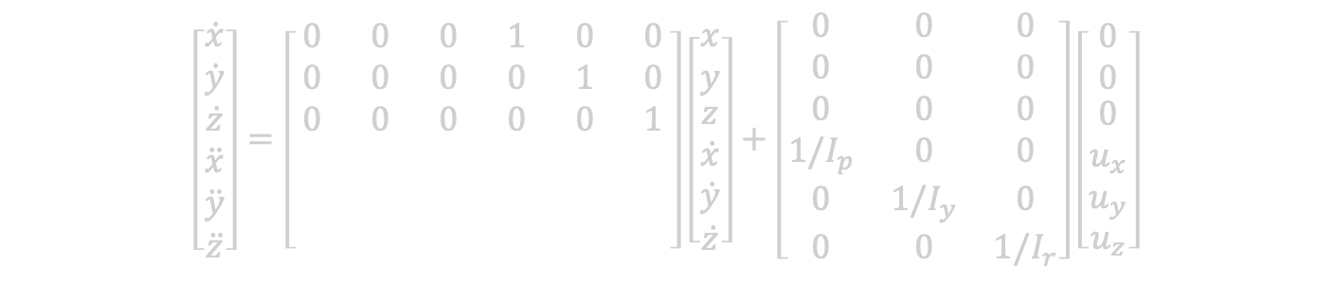
Equations of Motion
$$\dot{x}=Ax+Bu$$
$$y=Cx+Du$$
$$\left[\begin{matrix}\dot{x} \\ \dot{y} \\ \begin{aligned}\begin{aligned}\dot{z} \\ \ddot{x} \\ \ddot{y}\end{aligned} \\ \ddot{z}\end{aligned}\end{matrix}\right]=\left[\begin{matrix}0 & 0 & 0 & 1 & 0 & 0 \\ 0 & 0 & 0 & 0 & 1 & 0 \\ 0 & 0 & 0 & 0 & 0 & 1 \\ & & & & & \\ & & & & & \\ & & & & & \end{matrix}\right]\left[\begin{matrix}x \\ y \\ \begin{aligned}\begin{aligned}z \\ \dot{x} \\ \dot{y}\end{aligned} \\ \dot{z}\end{aligned}\end{matrix}\right]+\left[\begin{matrix}0 & 0 & 0 \\ 0 & 0 & 0 \\ 0 & 0 & 0 \\ 1/I_{p} & 0 & 0 \\ 0 & 1/I_{y} & 0 \\ 0 & 0 & 1/I_{r}\end{matrix}\right]\left[\begin{matrix}0 \\ 0 \\ \begin{aligned}\begin{aligned}0 \\ u_{x} \\ u_{y}\end{aligned} \\ u_{z}\end{aligned}\end{matrix}\right]$$

Slide 16
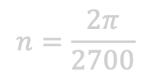
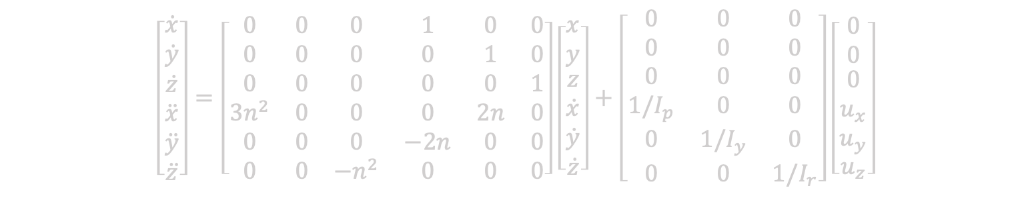
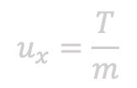
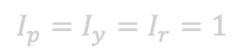
Equations of Motion
$$\dot{x}=Ax+Bu$$
$$y=Cx+Du$$
$$\left[\begin{matrix}\dot{x} \\ \dot{y} \\ \begin{aligned}\begin{aligned}\dot{z} \\ \ddot{x} \\ \ddot{y}\end{aligned} \\ \ddot{z}\end{aligned}\end{matrix}\right]=\left[\begin{matrix}0 & 0 & 0 & 1 & 0 & 0 \\ 0 & 0 & 0 & 0 & 1 & 0 \\ 0 & 0 & 0 & 0 & 0 & 1 \\ 3n^{2} & 0 & 0 & 0 & 2n & 0 \\ 0 & 0 & 0 & −2n & 0 & 0 \\ 0 & 0 & −n^{2} & 0 & 0 & 0\end{matrix}\right]\left[\begin{matrix}x \\ y \\ \begin{aligned}\begin{aligned}z \\ \dot{x} \\ \dot{y}\end{aligned} \\ \dot{z}\end{aligned}\end{matrix}\right]+\left[\begin{matrix}0 & 0 & 0 \\ 0 & 0 & 0 \\ 0 & 0 & 0 \\ 1/I_{p} & 0 & 0 \\ 0 & 1/I_{y} & 0 \\ 0 & 0 & 1/I_{r}\end{matrix}\right]\left[\begin{matrix}0 \\ 0 \\ \begin{aligned}\begin{aligned}0 \\ u_{x} \\ u_{y}\end{aligned} \\ u_{z}\end{aligned}\end{matrix}\right]$$
$$I_{p}=I_{y}=I_{r}=1$$
$$u_{x}=\frac{T}{m}$$
$$n=\frac{2π}{2700}$$

Slide 17
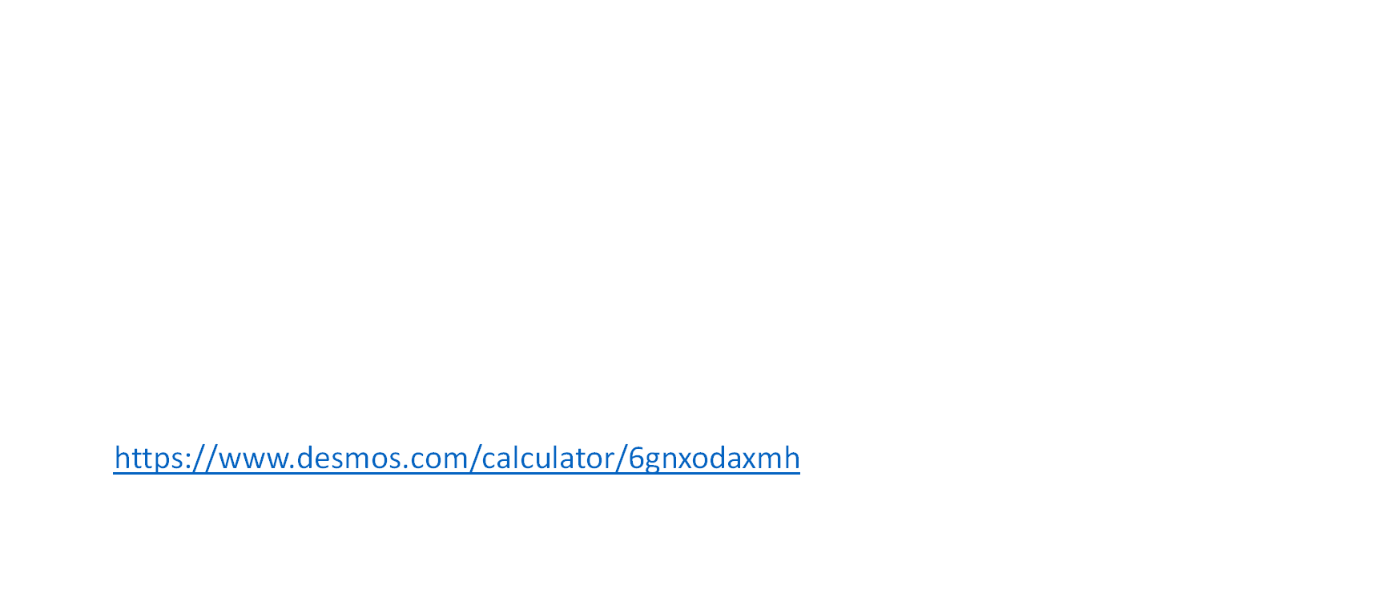
Solving the ODE
Boundary Value Problem (Define Boundaries: $x_{f},y_{f},z_{f}$)
Dimensional Reduction $ℝ^{3}→ℝ^{2}$
Apply assumptions
Parameterize solution in terms of:
$h_{1} :Initial Hop Height$
$d_{c} :Coast Distance$
$φ_{1} :Phase 2 Angle of Thrust (horizontal acceleration burn)$
$φ_{2} :Phase 4 Angle of Thrust (horizontal break burn)$
Trajectory Design Tool:
https://www.desmos.com/calculator/6gnxodaxmh
Numerical method
Euler’s method – Iteratively solve for every time step

Slide 18
Lyapunov Stability Analysis
A

Slide 19
Lyapunov Functions
Hamiltonian

Slide 20
Relative Orbit Dynamics

Slide 21
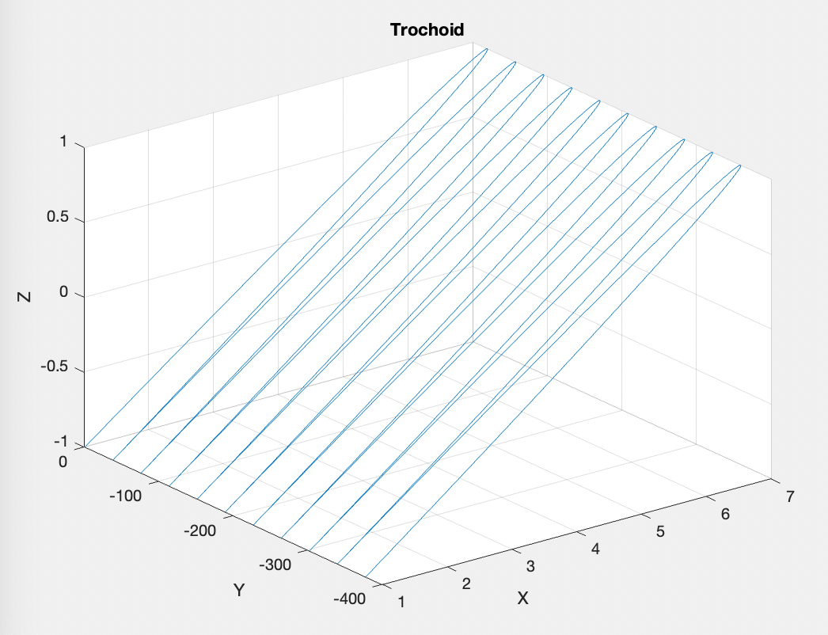
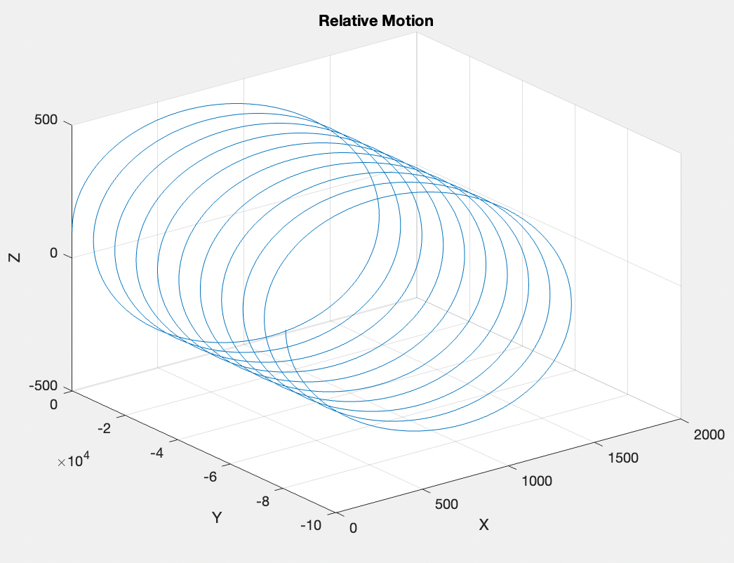
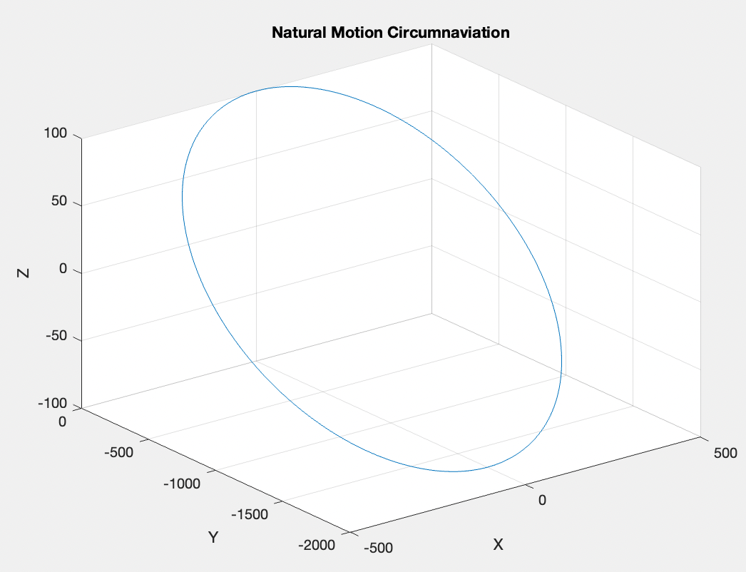
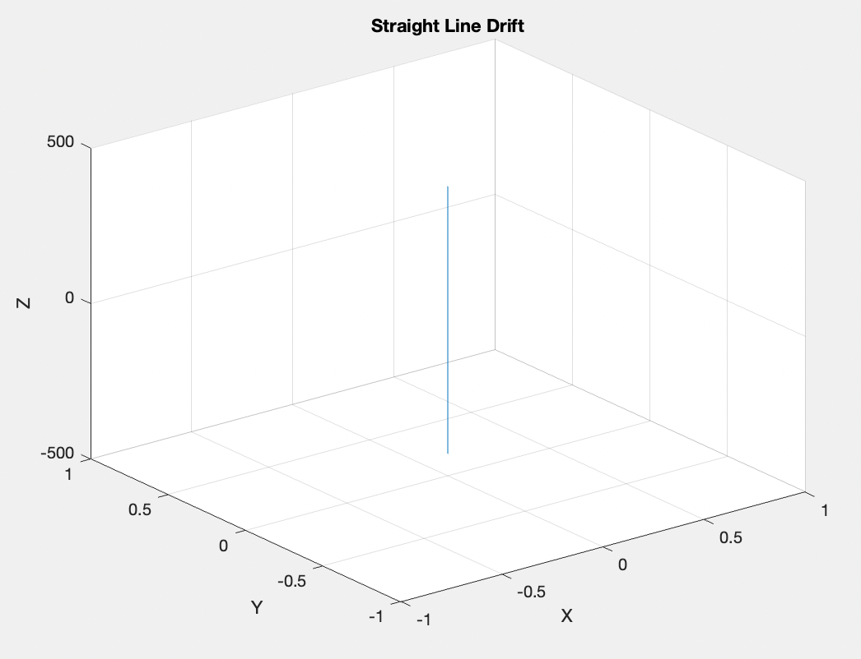
Relative Motion

Slide 22
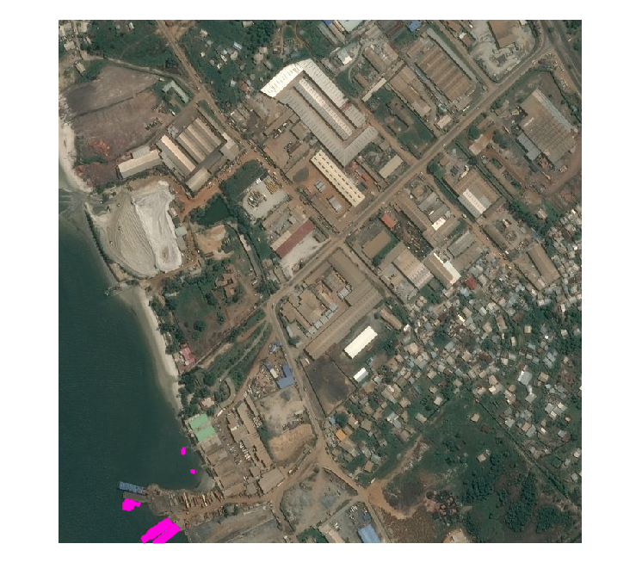
Sample Image
Ground Truth Overlaid onto Original Image

Slide 23
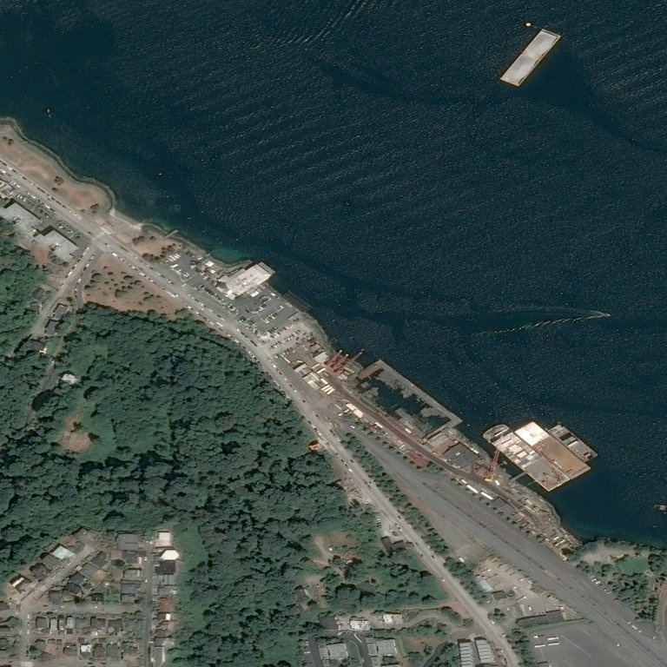
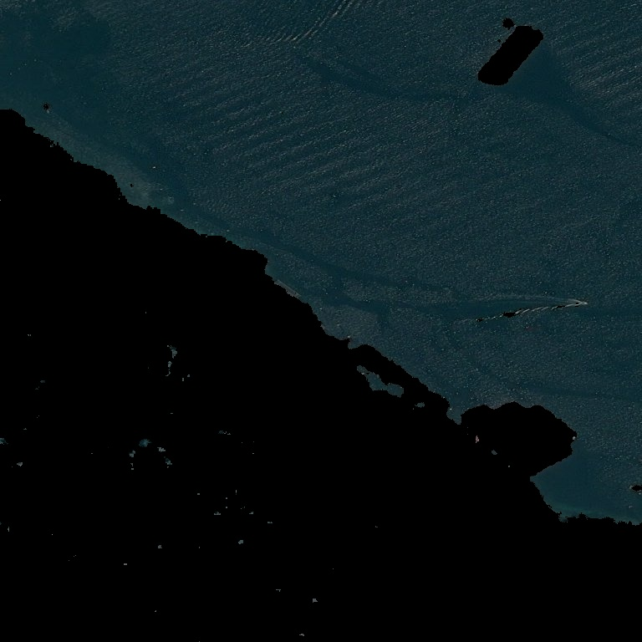
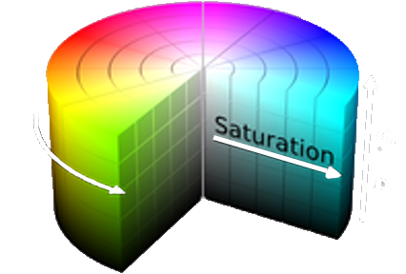
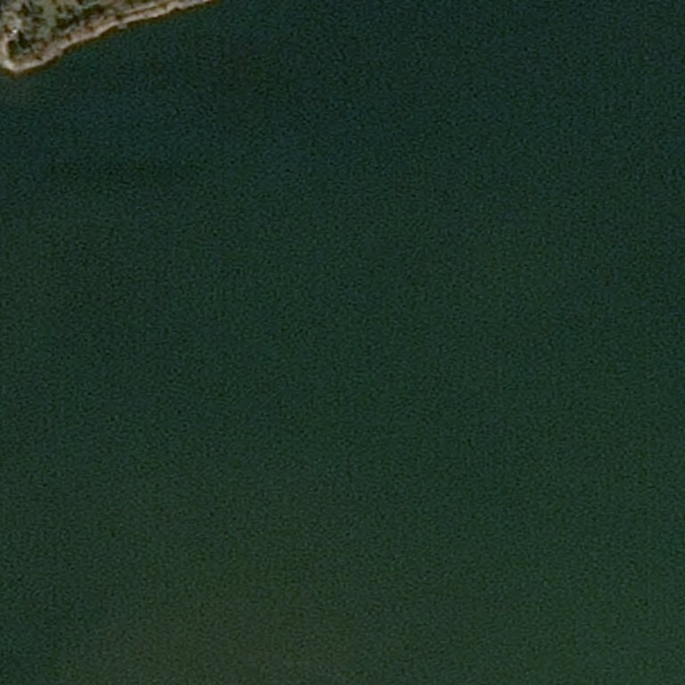
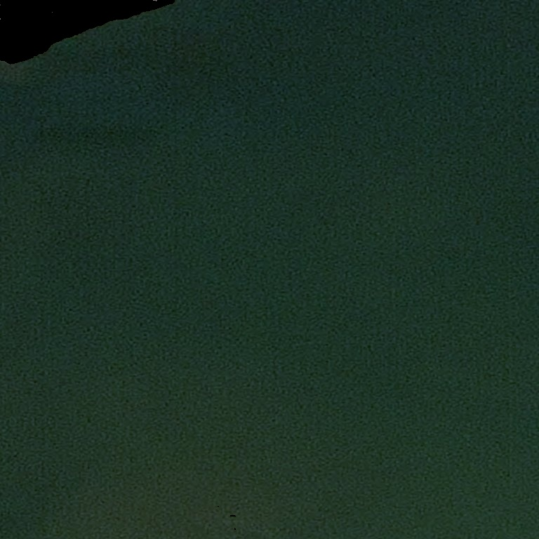
[Hue, Saturation, Value] Spectrum Filtering
Subtract Pixel Values
Not Within
HSV Range
[100, 255, 255]
[90, 20, 0]
Raw Image
HSV Filtered
[100, 255, 255]
[52, 0, 0]
Adaptive Thresholding
Needed

Slide 24
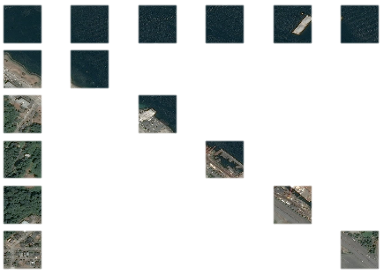
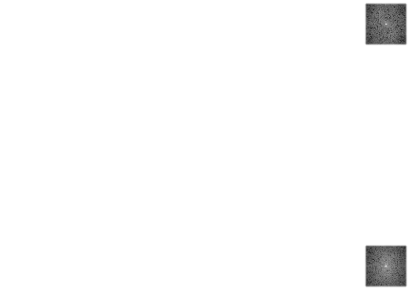
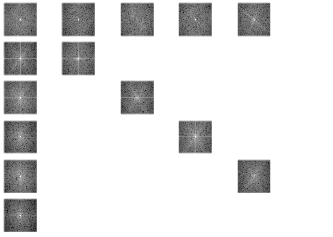
Fourier Transform Analysis
Signal Decomposition
Original
Fourier Transformed
Original Image
Signal

Slide 25
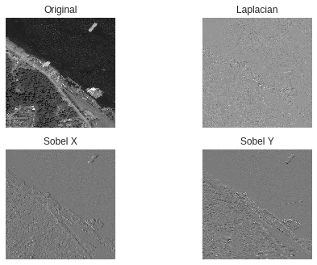
Other Possible Operations
Grey Scale
Sobel X
Sobel Y
Laplacian

Slide 26
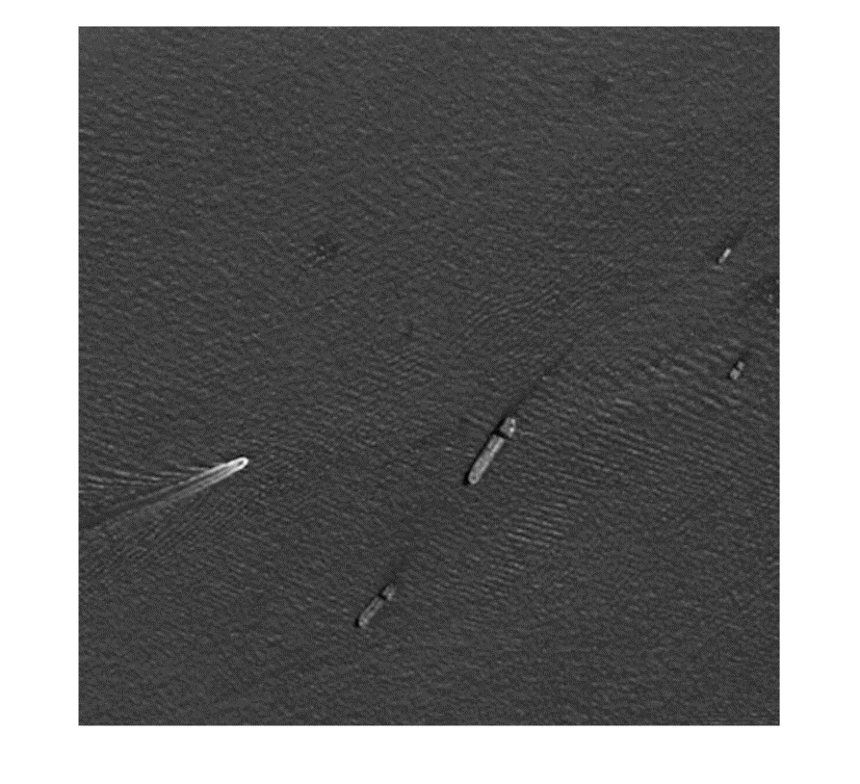
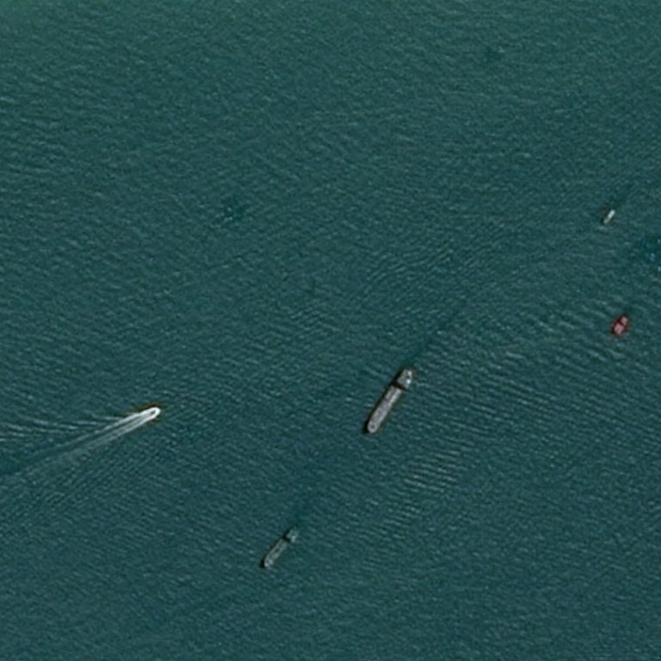
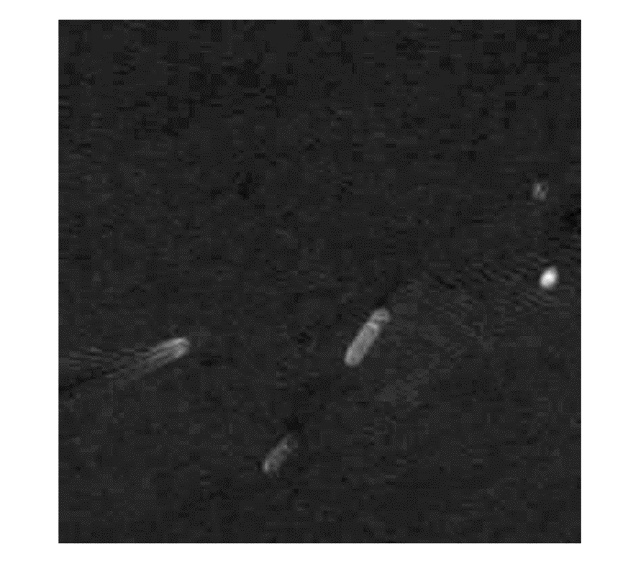
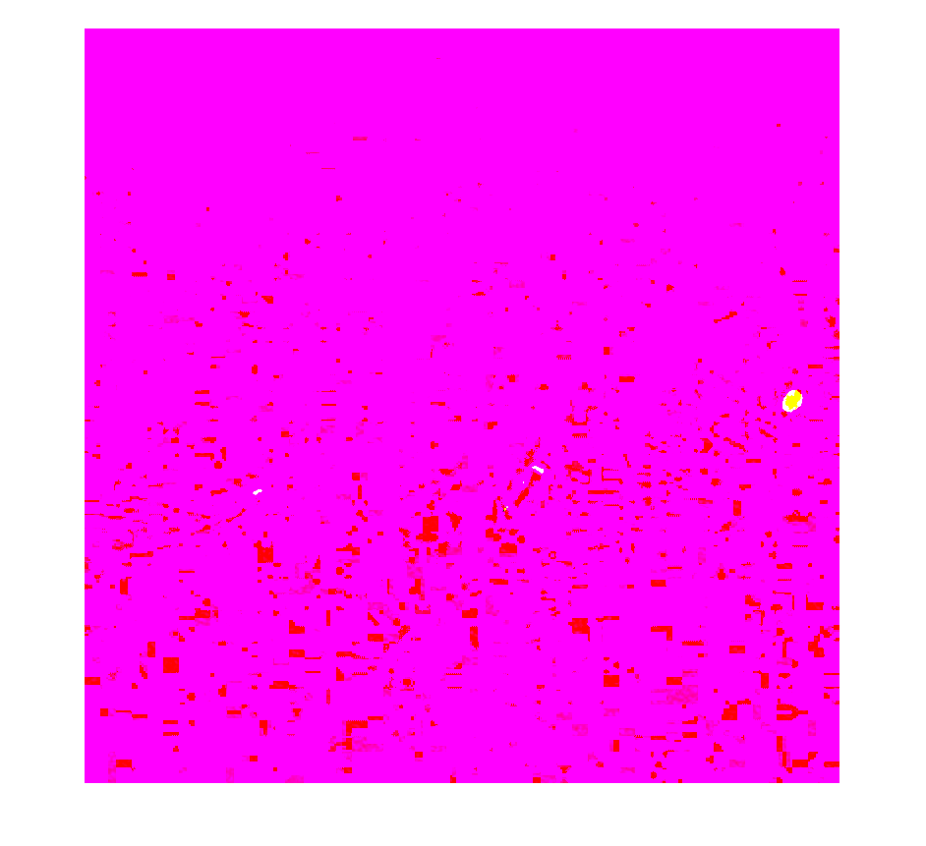
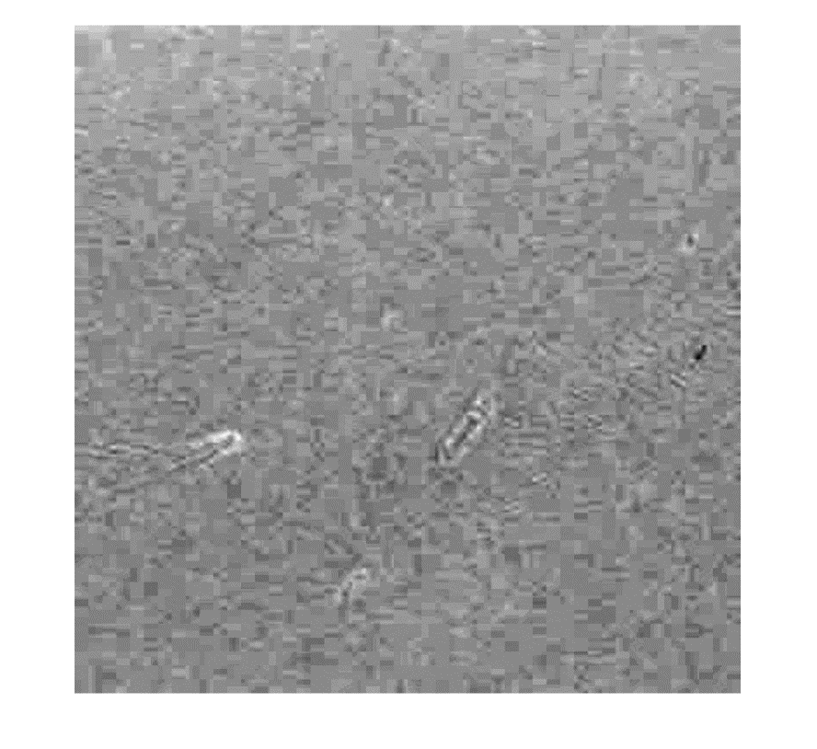
Principal Component Analysis
Original Image
Principal Components
Recombined
Decomposed Principal Components

Slide 27
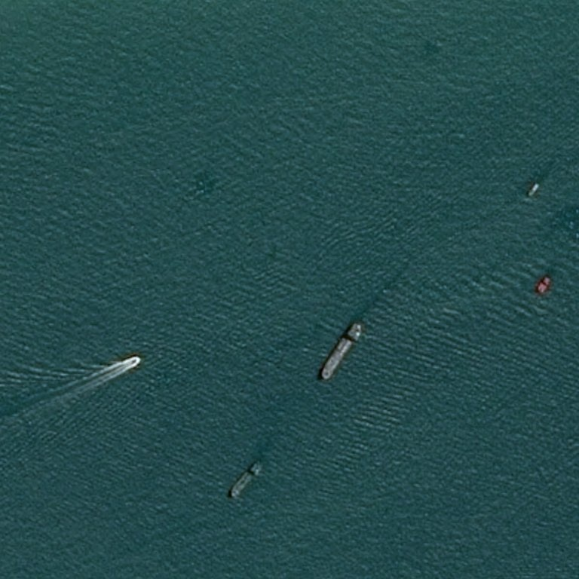
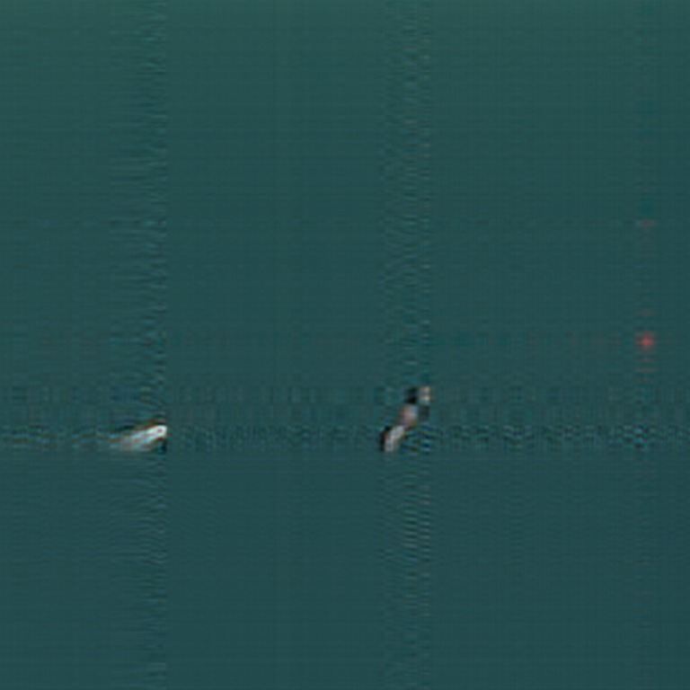
Singular Value Decomposition

Slide 28
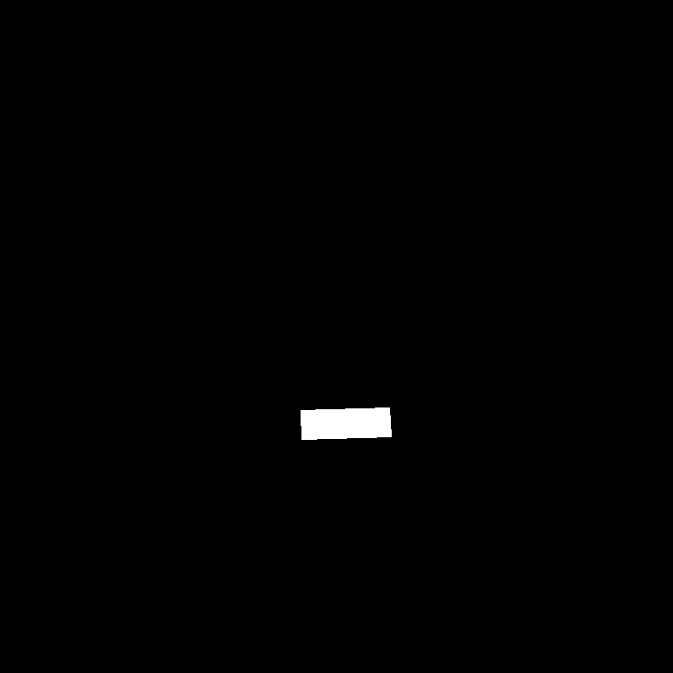
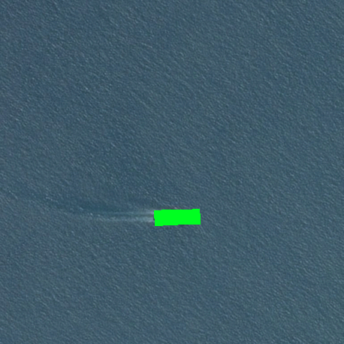
Run Length Decoding
[Pixel Index, Vector Length]
1x589,824 → 768x768
ImageId | EncodedPixels
000155de5.jpg | 264661 17 265429 33 266197 33 266965 33 267733 33 268501 33 269269 33 270037 33 270805 33 271573 33 272341 33 273109 33 273877 33 274645 33 275413 33 276181 33 276949 33 277716 34 278484 34 279252 33 280020 33 280788 33 281556 33 282324 33 283092 33 283860 33 284628 33 285396 33 286164 33 286932 33 287700 33 288468 33 289236 33 290004 33 290772 33 291540 33 292308 33 293076 33 293844 33 294612 33 295380 33 296148 33 296916 33 297684 33 298452 33 299220 33 299988 33 300756 33 301524 33 302292 33 303060 33 303827 34 304595 34 305363 33 306131 33 306899 33 307667 33 308435 33 309203 33 309971 33 310739 33 311507 33 312275 33 313043 33 313811 33 314579 33 315347 33 316115 33 316883 33 317651 33 318419 33 319187 33 319955 33 320723 33 321491 33 322259 33 323027 33 323795 33 324563 33 325331 33 326099 33 326867 33 327635 33 328403 33 329171 33 329938 34 330706 34 331474 33 332242 33 333010 33 333778 33 334546 33 335314 33 336082 33 336850 33 337618 33 338386 33 339154 33 339922 33 340690 33 341458 33 342226 33 343003 24 343787 8
Original Image
Decoded Mask
Mask Overlaid
+
=
768
768

Slide 29
Run Length Decoding – Pseudo Code
[Pixel Index, Vector Length]
1x589,824 → 768x768
Loop Through CSV File
If line has no ship
Create a [768, 768] mask of zeros
Else If line is the same as the previous line // it means its another ship
Convert Pixel Index to [Row, Column]
Create Vector Length of 1s beginning at [Row, Column]
Add to previous mask
Else
Convert Pixel Index to [Row, Column]
Create Vector Length of 1s beginning at [Row, Column]
Add to new mask
Create .PNG file from mask

Slide 30
Network Overview
Input
Output
rgb | rgb | rgb | rgb | rgb | rgb | rgb | rgb | rgb | rgb
rgb | rgb | rgb | rgb | rgb | rgb | rgb | rgb | rgb | rgb
rgb | rgb | rgb | rgb | rgb | rgb | rgb | rgb | rgb | rgb
rgb | rgb | rgb | rgb | rgb | rgb | rgb | rgb | rgb | rgb
rgb | rgb | rgb | rgb | rgb | rgb | rgb | rgb | rgb | rgb
rgb | rgb | rgb | rgb | rgb | rgb | rgb | rgb | rgb | rgb
rgb | rgb | rgb | rgb | rgb | rgb | rgb | rgb | rgb | rgb
rgb | rgb | rgb | rgb | rgb | rgb | rgb | rgb | rgb | rgb
rgb | rgb | rgb | rgb | rgb | rgb | rgb | rgb | rgb | rgb
rgb | rgb | rgb | rgb | rgb | rgb | rgb | rgb | rgb | rgb
0 | 0 | 0 | 0 | 0 | 0 | 0 | 0 | 0 | 0
0 | 0 | 0 | 0 | 0 | 0 | 0 | 255 | 0 | 0
0 | 0 | 0 | 0 | 0 | 0 | 0 | 255 | 0 | 0
0 | 0 | 0 | 0 | 0 | 0 | 0 | 0 | 0 | 0
0 | 0 | 0 | 0 | 0 | 0 | 0 | 0 | 0 | 0
0 | 0 | 0 | 0 | 0 | 0 | 0 | 0 | 0 | 0
0 | 0 | 0 | 0 | 0 | 0 | 0 | 0 | 0 | 0
0 | 255 | 255 | 255 | 0 | 0 | 0 | 0 | 0 | 0
0 | 255 | 255 | 255 | 0 | 0 | 0 | 0 | 0 | 0
0 | 0 | 0 | 0 | 0 | 0 | 0 | 0 | 0 | 0
Layers
‘Mathemagic’
Original Image
Classification Mask
768x768x3
768x768x1

Slide 31
Comparison
Confusion Matrices Produced from 100 Image Test
v3 | Predicted Background | Predicted Ship
Actual Background | 92.68% | 7.32%
Actual Ship | 44.95% | 55.05%
v4 | Predicted Background | Predicted Ship
Actual Background | 98.89% | 1.12%
Actual Ship | 38.54% | 61.50%
v5 | Predicted Background | Predicted Ship
Actual Background | 98.89% | 1.11%
Actual Ship | 22.67% | 77.34%
v8 | Predicted Background | Predicted Ship
Actual Background | 99.64% | 0.36%
Actual Ship | 28.98% | 71.03%
Depth:
Layers:
Pixel Augmentation:
Training Set:
Epochs:
1
31
Randomize
[10, 10]
4,421 Images
5
Depth:
Layers:
Pixel Augmentation:
Training Set:
Epochs:
4
59
Randomize
[10, 10]
5,128 Images
5
Depth:
Layers:
Pixel Augmentation:
Training Set:
Epochs:
6
87
Randomize
[10, 10]
5,128 Images
5
Depth:
Layers:
Pixel Augmentation:
Training Set:
Epochs:
7
101
Randomize
[9, 9]
6,632 Images
15

Slide 32
Minting policy
cap
Total Supply
Time

Slide 33
References
A

